Slide 1
Electron Transfer Chain

Slide 2
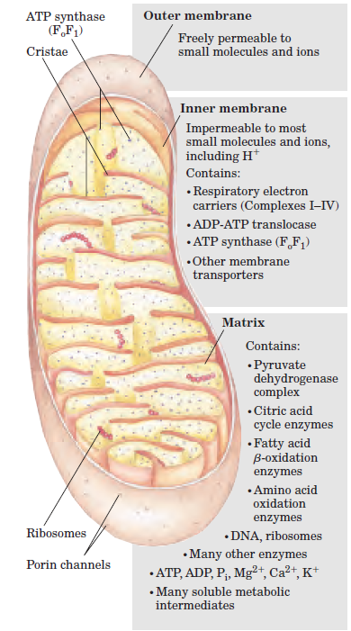
Oxidative phosphorylation
Mitochondria, has two menbranes:
The outer mitochondrial membrane is readily permeable to small molecules (Mr 5,000) and ions, which move freely
through transmembrane channels formed by a family of integral membrane proteins called porins.
The inner membrane is impermeable to most small molecules and ions, including protons (H).
the only species that cross this membrane do so through specific transporters.
The selectively permeable inner membrane segregates the intermediates and enzymes of cytosolic metabolic pathways from those of metabolic processes occurring in the matrix.

Slide 3
Electron Carriers
Oxidative phosphorylation begins with the entry of electrons into the respiratory chain.
Dehydrogenases collect electrons from catabolic pathways and funnel them into universal electron acceptors—nicotinamide nucleotides (NAD or NADP) or flavin nucleotides (FMN or FAD).
FMN (Flavin MonoNucleotide) is a prosthetic group of some flavoproteins.
It is similar in structure to FAD (Flavin Adenine Dinucleotide), but lacking the adenine nucleotide.
FMN (like FAD) can accept 2 e⁻ + 2 H⁺ to form FMNH₂.

Slide 4

FMN, when bound at the active site of some enzymes, can accept 1 e⁻ to form the half-reduced semiquinone radical. The semiquinone can accept a 2nd e⁻ to yield FMNH₂.
Since it can accept/donate 1 or 2 e⁻, FMN has an important role mediating e⁻ transfer between carriers that transfer 2e⁻ (e.g., NADH) & those that can accept only 1e⁻ (e.g., Fe⁺⁺⁺).

Slide 5
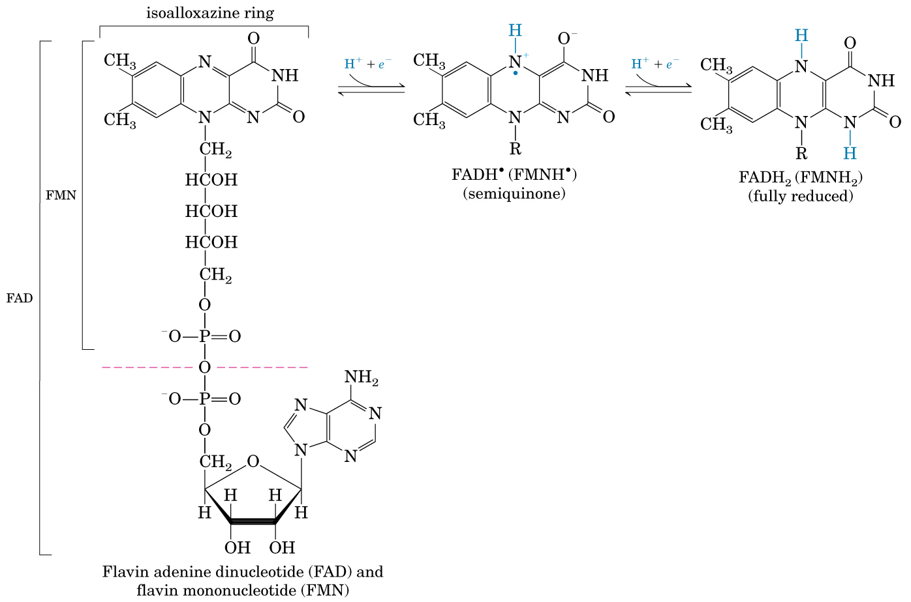
FAD

Slide 6
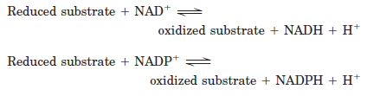
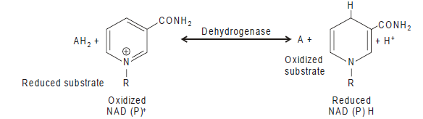
NAD(P)H
Nicotinamide nucleotide–linked dehydrogenases catalyze reversible reactions of the following general types:
Neither NADH nor NADPH can cross the inner mitochondrial membrane, but the electrons they carry can be shuttled across indirectly.
How?

Slide 7
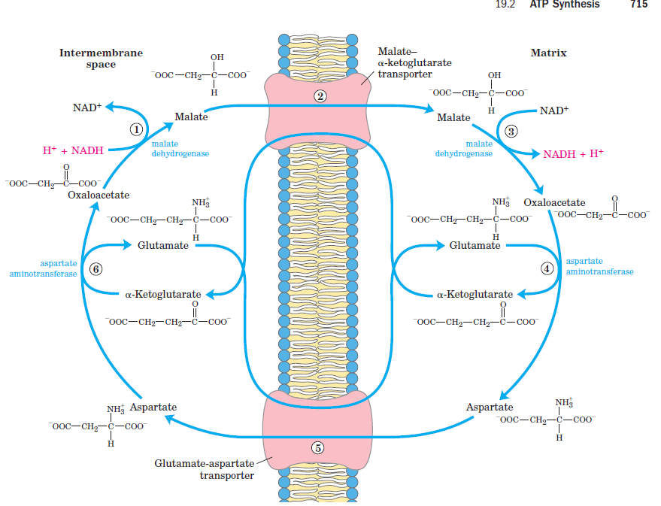
Malate-aspartate shuttle. (liver, kidney, and heart mitochondria)

Slide 8
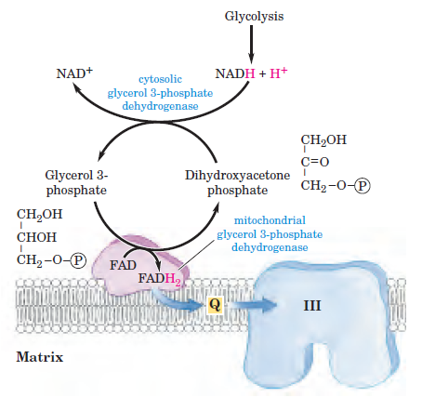
glycerol 3-phosphate shuttle (Skeletal muscle and brain)

Slide 9
In addition to NAD and flavoproteins, three other types of electron-carrying molecules function in the respiratory
chain:
Ubiquinone (Coenzyme Q).
Cytochromes
Iron sulfur proteins

Slide 10
Coenzyme Q (Ubiquinone ,CoQ, Q)
Is the only non-protein component of electron transport chain.
Coenzyme Q (CoQ, Q, ubiquinone) is very hydrophobic.
It dissolves in the hydrocarbon core of the inner mitochondrial membrane.
It includes a long isoprenoid tail, with multiple units having a carbon skeleton comparable to that of isoprene.
In human cells, most often n = 10.

Slide 11
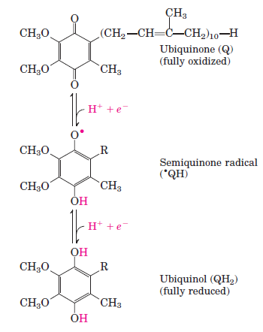
Ubiquinone can accept one electron to become the semiquinone radical (∙QH) or two electrons to form ubiquinol (QH2) :
Coenzyme Q functions as a mobile e⁻ carrier within the mitochondrial inner membrane.

Slide 12
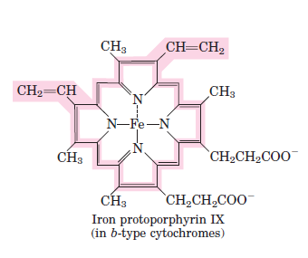
Cytochromes
The cytochromes are proteins with characteristic strong absorption of visible light, due to their iron containing heme prosthetic groups.
Three types exists: Cytochrome a,b and c.
Are distinguished by differences in their light-absorption spectra.
The Heme prosthetic group of cytochromescontains an iron atom in a porphyrin ring system.
The Fe is bonded to 4 N atoms of the porphyrin ring.
The iron participates in redox reactions and oscillates between Fe²⁺ and Fe³⁺ states.
Hemes in the 3 classes of cytochrome (a, b, c) differ slightly in substituents on the porphyrin ring system

Slide 13
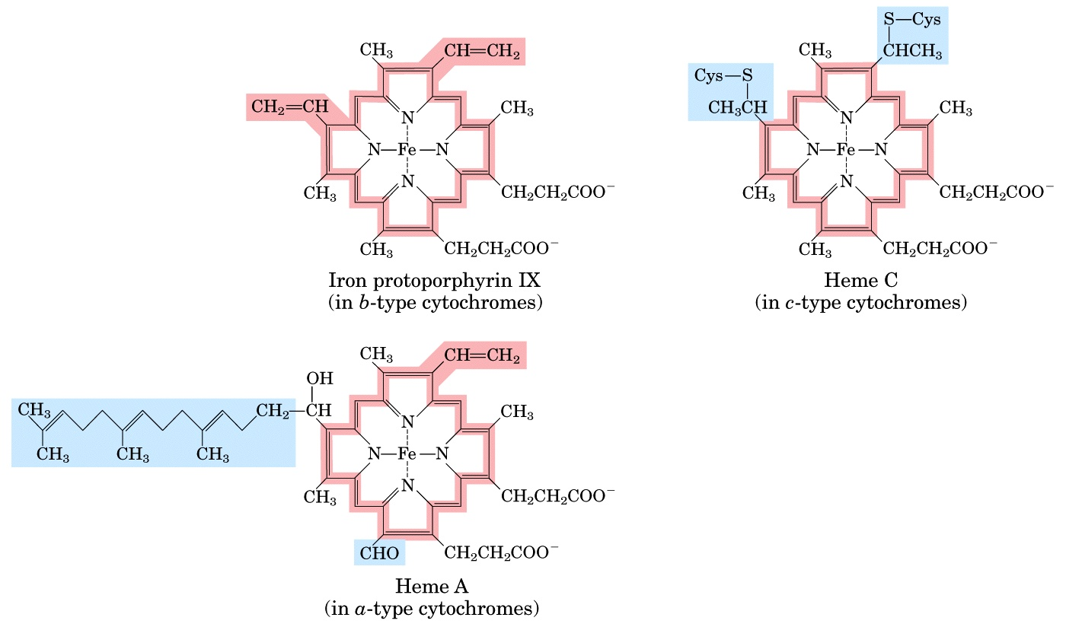
Prosthetic groups of cytochromes
Heme is a prosthetic group of cytochromes
Mitochondria has 3 classes of cytochromes,designated a, b, and c
Found in Hb
The heme iron atom can undergo a 1 electron transition between ferric and ferrous states:
Fe³⁺ + e⁻ <--> Fe²⁺

Slide 14
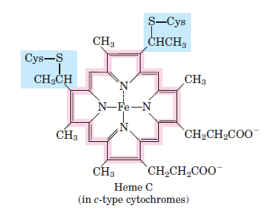
Only heme c is covalently linked to the protein via thioether bonds to cysteine residues.

Slide 15
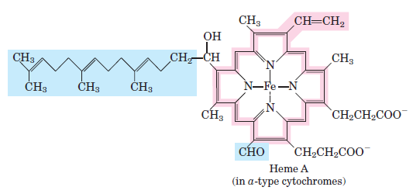
Heme a is unique in having a long farnesyl side-chain that includes 3 isoprenoid units.
Note: A common feature is 2 propionate side-chains.

Slide 16
Cytochromes are proteins with heme prosthetic groups. They absorb light at characteristic wavelengths.
Absorbance changes upon oxidation/reduction of the heme iron provide a basis for monitoring heme redox state.
  Some cytochromes are part of large integral membrane complexes, each consisting of several polypeptides & including multiple electron carriers.
  E.g., hemes a & a₃ that are part of the respiratory chain complex IV are often referred to as cytochromes a & a₃.
  Cytochrome c is instead a small, water-soluble protein with a single heme group.

Slide 17
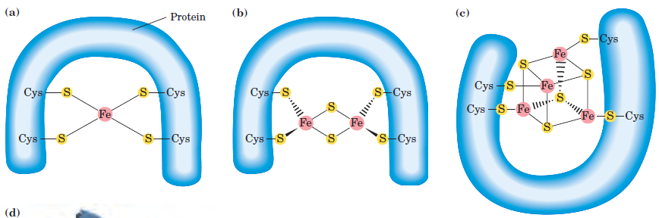
Iron-sulfur centers
Iron-sulfur centers (Fe-S) are prosthetic groups containing 2, 3 , 4 or 8 iron atoms complexed to elemental & cysteine S
Cysteine residues provide S ligands to the iron, while also holding these prosthetic groups in place within the protein.

Slide 18
Electron transfer proteins may contain multiple Fe-S centers.
Iron-sulfur centers transfer only one electron, even if they contain two or more iron atoms, because of the close proximity of the iron atoms.
E.g., a 4-Fe center might cycle between redox states:
Fe⁺⁺⁺₃, Fe⁺⁺₁ (oxidized) + 1 e⁻ ←→ Fe⁺⁺⁺₂, Fe⁺⁺₂ (reduced)

Slide 19
Respiratory Chain:
Most constitutents of the respiratory chain are embedded in the inner mitochondrial membrane (or in the cytoplasmic membrane of aerobic bacteria).
The inner mitochondrial membrane has infoldings called cristae that increase the membrane area.

Slide 20
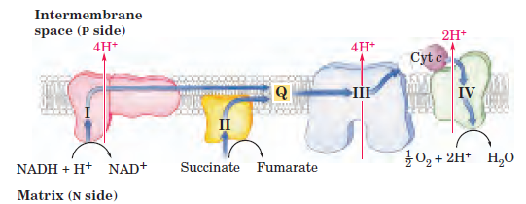
Electrons are transferred from NADH → O₂ via multisubunit inner membrane complexes I,II III & IV, plus CoQ & cyt c.
Within each complex, electrons pass sequentially through a series of electron carriers.
CoQ is located in the lipid core of the membrane. There are also binding sites for CoQ within protein complexes with which it interacts.
Cytochrome c resides in the intermembrane space.
It alternately binds to complex III or IV during e⁻ transfer.

Slide 21
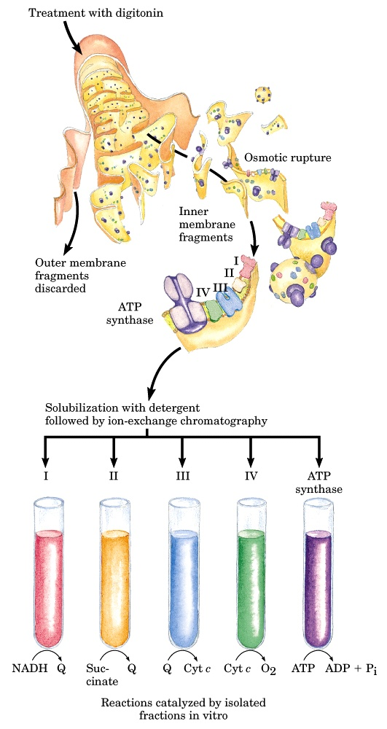
Individual respiratory chain complexes have been isolated and their composition determined.
Components of the electron transport chain can be purified from the mitochondrial inner membrane
There is also evidence for the existence of stable supramolecular aggregates containing multiple complexes.

Slide 22
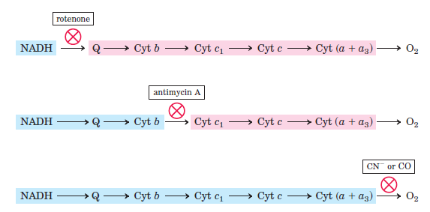
Method for determining the sequence if electron carreirs
Inhibitors at various points of the respiratory chain were used

Slide 23
Composition of Respiratory Chain Complexes
Complex
Name
No. of Proteins
Prosthetic Groups
Complex I
NADH Dehydrogenase
46
FMN,
9 Fe-S cntrs.
Complex II
Succinate-CoQ Reductase
5
FAD, cyt b₅₆₀,
3 Fe-S cntrs.
Complex III
CoQ-cyt c Reductase
11
cyt b_{H}, cyt b_{L}, cyt c₁, Fe-S_{Rieske}
Complex IV
Cytochrome Oxidase
13
cyt a, cyt a₃, Cu_{A}, Cu_{B}

Slide 24
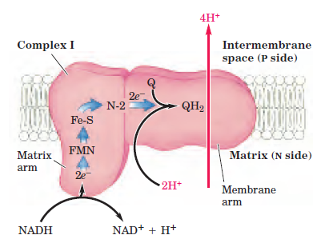
Complex I catalyzes oxidation of NADH, with reduction of coenzyme Q:
NADH + H⁺ + Q → NAD⁺ + QH₂
An atomic-level structure is not yet available for the entire complex I, which in mammals includes at least 46 proteins, along with prosthetic groups FMN & several Fe-S centers.

Slide 25
Complex I is L-shaped.
The peripheral domain, containing the FMN that accepts 2e⁻ from NADH, protrudes into the mitochondrial matrix.
Iron-sulfur centers are also located in the hydrophilic peripheral domain, where they form a pathway for e⁻ transfer from FMN to coenzyme Q.
A binding site for coenzyme Q is thought be close to the interface between peripheral and intra-membrane domains.

Slide 26
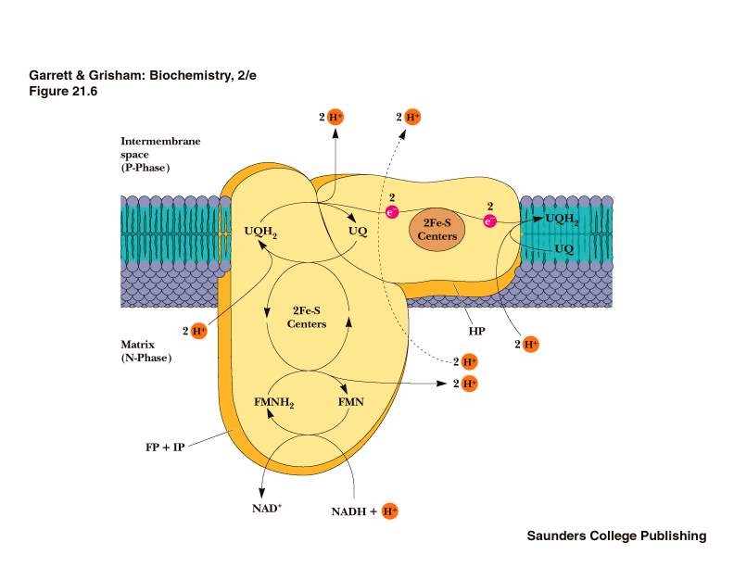
Mechanism of e- transfer in Complex I
o
r
o
r
o
r
o
Estimated mass of this complex 850 kD
Involves more than 30 polypeptide chains
One molecule of FMN
As many as 7 Fe-S clusters (2Fe-2S & 4Fe-4S)
Precise mechanism of this complex is unknown

Slide 27
The initial electron transfers are:
NADH + H⁺ + FMN → NAD⁺ + FMNH₂
FMNH₂ + (Fe-S)_{ox} → FMNH· + (Fe-S)_{red} + H⁺
After Fe-S is reoxidized by transfer of the electron to the next iron-sulfur center in the pathway:
FMNH· + (Fe-S)_{ox} → FMN + (Fe-S)_{red} + H⁺
Electrons pass through a series of iron-sulfur centers, and are eventually transferred to coenzyme Q.
Coenzyme Q accepts 2 e⁻ and picks up 2 H⁺ to yield the fully reduced QH₂.

Slide 28
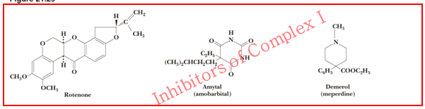
Inhibitors of complex 1
Amytal (a barbiturate drug), rotenone (a plant product commonly used as an insecticide), and piericidin A (anantibiotic) inhibit electron flow from the Fe-S centers of Complex I to ubiquinone and therefore block the overall process of oxidative phosphorylation.

Slide 29
Complex II
Succinate Dehydrogenase of the Krebs Cycle is also called complex II or Succinate-CoQ Reductase.
FAD is the initial e⁻ acceptor.
FAD is reduced to FADH₂ during oxidation of succinate to fumarate.
FADH₂ is then reoxidized by transfer of electrons through a series of 3 iron-sulfur centers to CoQ, yielding QH₂.
The QH₂ product is then reoxidized via complex III, providing a pathway for transfer of electrons from succinate into the respiratory chain.

Slide 30
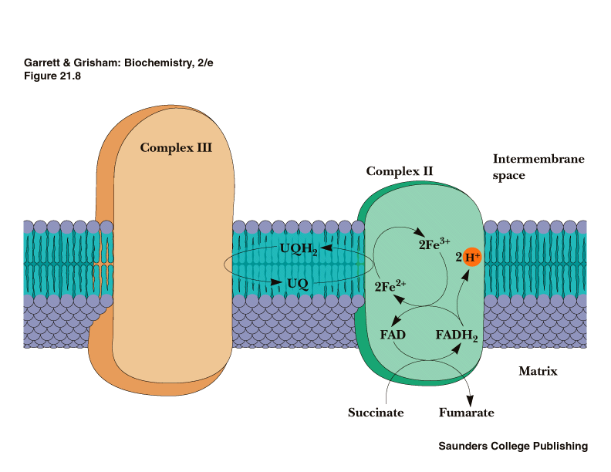
H⁺ transport does not occur in this complex
Complex II
Succinate-CoQ Reductase
or
Succinate dehydrogenase
(from TCA cycle!)
Mass of 100 – 140 kD
Composed of 4 subunits, including 2 Fe-S proteins
Three types of Fe-S cluster: 4Fe-4S, 3Fe-4S, 2Fe-2S
Path: Succinate FADH₂ 2Fe²⁺ UQH₂

Slide 31
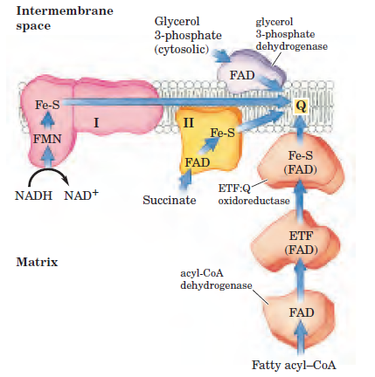
Path of electrons from NADH, succinate, fatty
acyl–CoA, and glycerol 3-phosphate to ubiquinone.

Slide 32
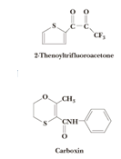
Inhibitors of complex II
2-Thenoyltrifluoroacetone & carboxin block complex II

Slide 33

Complex III (Cytochrome Reductase)
Accepts electrons from coenzyme QH₂ that is generated by electron transfer in complexes I & II.
Couples the transfer of electrons from ubiquinol (QH₂) to cytochrome c with the vectorial transport of protons from the matrix to the intermembrane space.
Cytochrome c₁, a prosthetic group within complex III, reduces cytochrome c, which is the electron donor to complex IV.

Slide 34
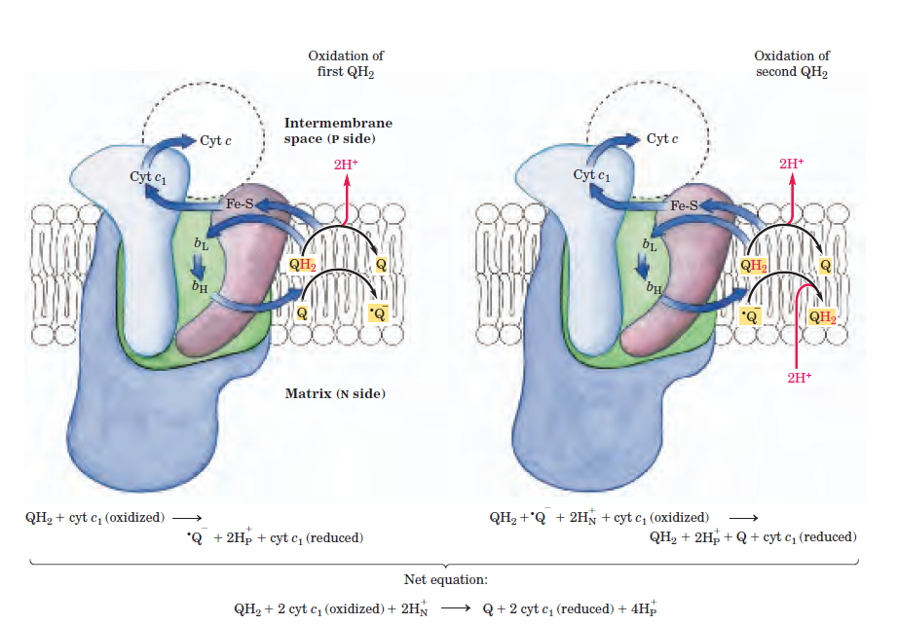
The Q cycle.

Slide 35
Inhibitors of complex III
Antimycin A:
An antibiotic blocks electron transport by inhibiting cytochrome reductase.
BAL (British anti lewisite):
Used as therapeutic agent in the cases of arsenic poisoning. It inhibits activity of cytochrome reductase.

Slide 36
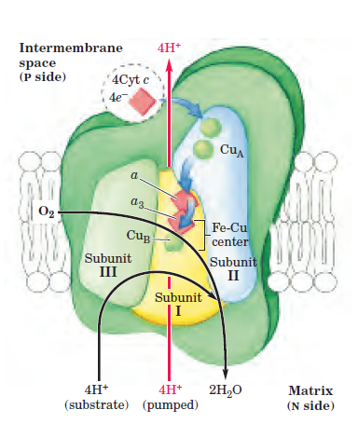

Cytochrome oxidase (complex IV) carries out the following irreversible reaction:
The four electrons are transferred into the complex one at a time from cytochrome c.

Slide 37
Inhibitors of complex IV
Cyanide (CN)
A powerful poison that inhibit cytochrome oxidase by combining with cytochrome a3.
Cyanide may arise from cyanogenic substance.
Carbon monoxide (CO)
It inhibits activity of cytochrome oxidase. (a pollutant).
3. Hydrogen sulfide (H₂S)
It inhibits cytochrome oxidase. H₂S toxicity occurs during oil drilling operations.
It is toxic as cyanide. It is a part of natural gas.
Azide:
Sodium azide also inhibits cytochrome oxidase activity.

Slide 38
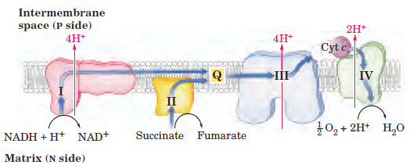
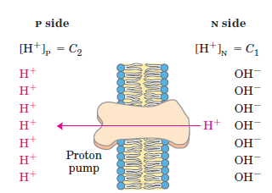
The Energy of Electron Transfer Is Efficiently Conserved in a Proton Gradient
Proton gradient
Proton gradient created as electrons transferred to oxygen forming water
  10 H⁺ / NADH
  6 H⁺ / FADH₂

Slide 39
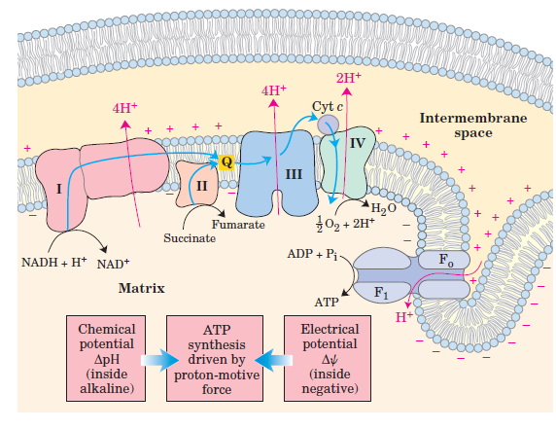
ATP synthesis
The Proton Gradient Drives ATP Synthesis. How??

Slide 40
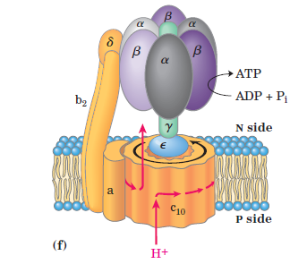
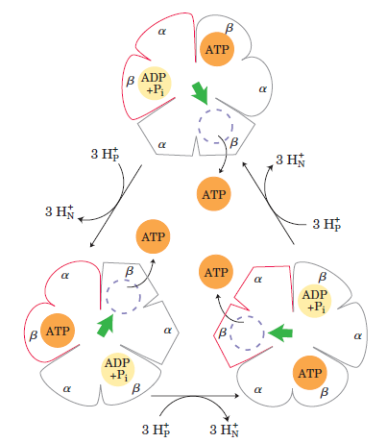
F₁F₀-ATP synthase of E.Coli.
F₁ portion
is composed of several subunits.
It contains three α, three β and one γ, δ and ε sub units,designated as α₃ β₃ γ₁ δ₁ ε₁.
F₀ portion
is composed of one a, two b, and twelve c subunits.
Binding-change model for ATP synthase.
Proposed by Paul Boyer.
The F1 complex has three nonequivalent adenine nucleotide–binding sites, one for each pair of α and β subunits.
At any given moment, one of these sites is in the β-ATP conformation (which binds ATP tightly), a second
is in the β-ADP (loose-binding) conformation, and a third is in the β-empty (very-loose-binding) conformation.
proton-motive force causes rotation of the central shaft—the γ subunit comes into contact with each αβ subunit pair in
Succession, producing cooperative conformational changes.

Slide 41
Generation of ATP
Proton dependant ATP synthetase
  Uses proton gradient to make ATP
  Protons pumped through channel on enzyme
    From intermembrane space into matrix
    ~4 H⁺ / ATP
  Called chemiosmotic coupling theory.
  Other theories include: Chemical coupling theory & Conformational coupling theory.
Totals
NADH
  10 H⁺ X 1 ATP = 2.5 ATP
  4 H⁺
  FADH₂
  6 H⁺ X 1 ATP = 1.5 ATP
  4 H⁺

Slide 42
Uncouplers of Oxidative phosphorylation
These compounds dissociates or uncouples oxidation in respiratory chain from phosphorylation.
So, the oxidation takes place without ATP synthesis.
Examples:
2, 4-dinitrophenol
Dinitrocresol
Salicylanilides
Pentachlorophenol
CCCP (Carbonylcyanide chloromethoxy phenyl hydrazone).
FCCP (Carbanoyl cyanide p. trifluoromethoxy phenyl hydrazone).
Thermogenin

Slide 43
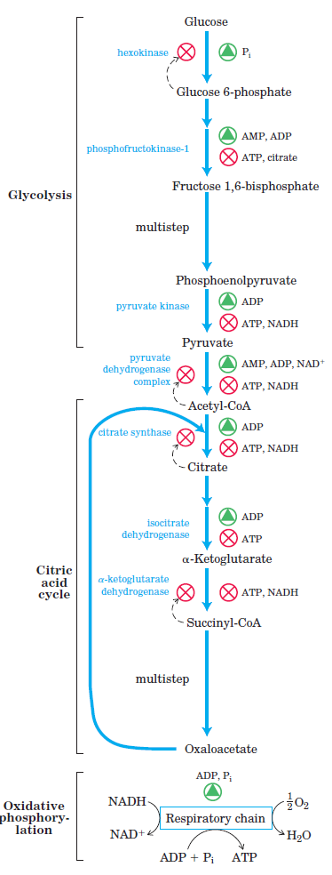
Regulation of Oxidative phosphorylation.
Oxidative phosphorylation in the respiratory chain is subjected to regulation like any metabolic pathway.
The rate of respiration is generally limited by the availability of substrates such as: ADP, Pi, NADH, FADH₂ and O₂.

Slide 44
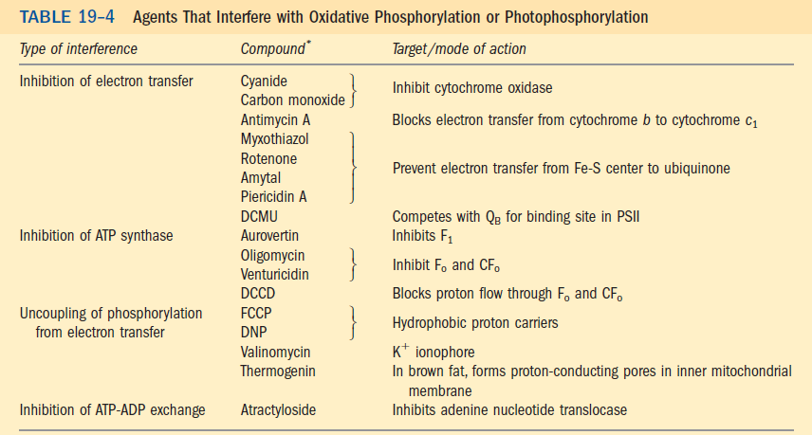

Slide 45
Oxidative phosphorylation
This is the process by which ADP is phosphorylated with inorganic phosphate to generate ATP.
NADH₂ has a central role in this process.
Electrons are transferred down the respiratory chain from NADH₂ to oxygen. This is because NADH₂ is a strong electron donor while oxygen is a strong electron acceptor.

